Slide 1
Negative Sequence Compensation via GSC and RSC to mitigate Stator Voltage Unbalance in DFIG
M. Shamaas
2018-MS-EE-4

Slide 2
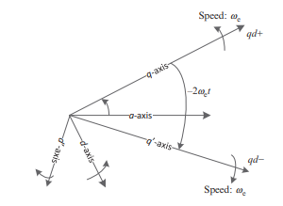
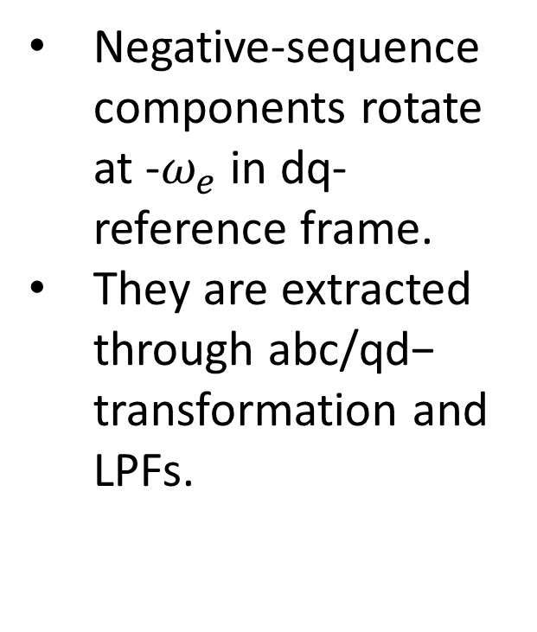
Stator Voltage Unbalance and Negative Sequence Components
Negative-sequence components rotate at -$ω_{e}$ in dq- reference frame.
They are extracted through abc/qd− transformation and LPFs.

Slide 3
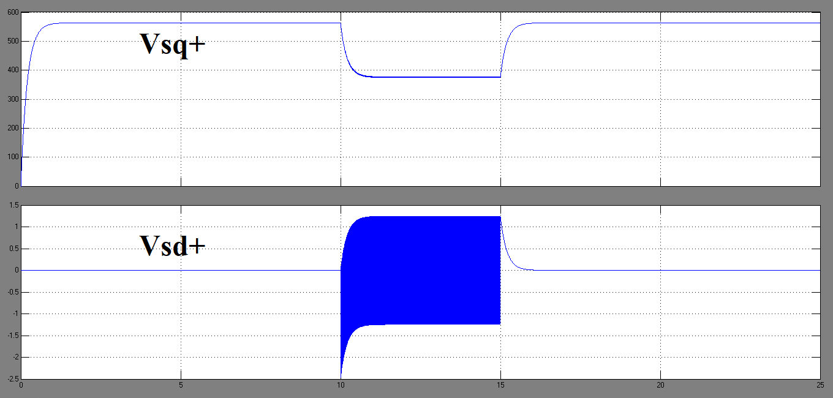
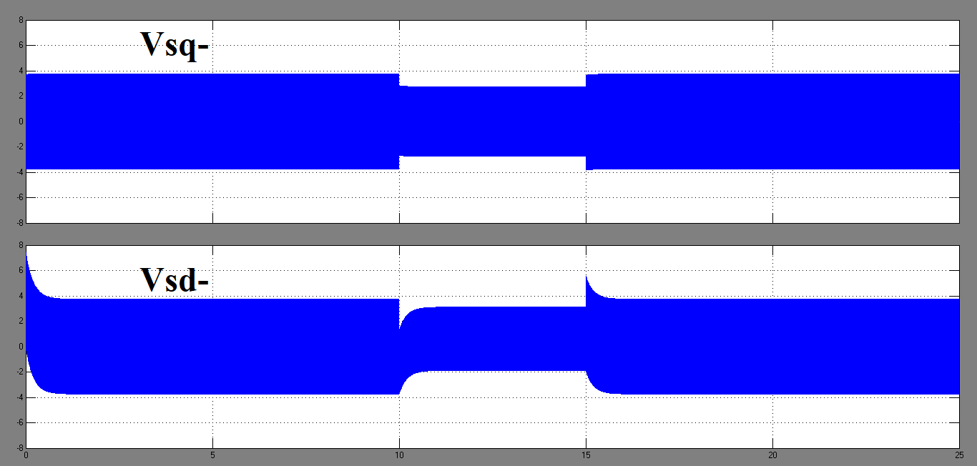
Stator Phase a Voltage Collapses to zero for t=10s to t=15s

Slide 4
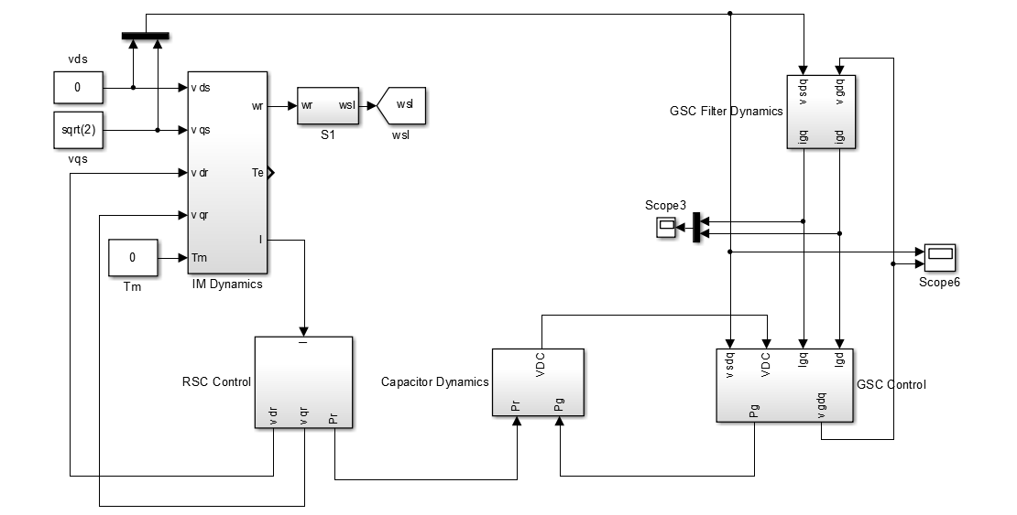
Complete DFIG Simulation Model

Slide 5
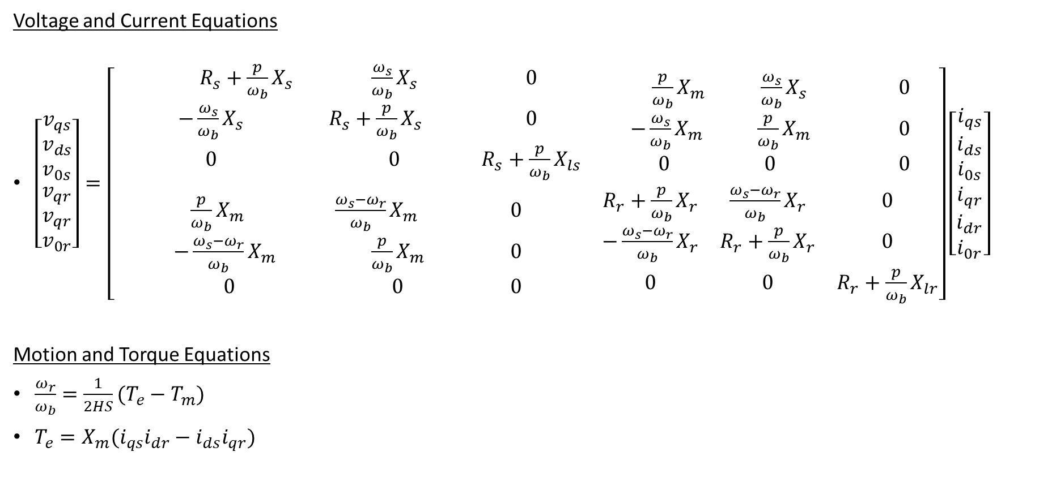
Induction Machine dq0-axis Model
Voltage and Current Equations
$\left[\begin{matrix}\begin{matrix}v_{qs} \\ v_{ds} \\ v_{0s}\end{matrix} \\ \begin{matrix}v_{qr} \\ v_{qr} \\ v_{0r}\end{matrix}\end{matrix}\right]=\left[\begin{matrix}\begin{matrix} R_{s}+\frac{p}{ω_{b}}X_{s} & \frac{ω_{s}}{ω_{b}}X_{s} & 0 \\ −\frac{ω_{s}}{ω_{b}}X_{s} & R_{s}+\frac{p}{ω_{b}}X_{s} & 0 \\ 0 & 0 & R_{s}+\frac{p}{ω_{b}}X_{ls}\end{matrix} & \begin{matrix}\frac{p}{ω_{b}}X_{m} & \frac{ω_{s}}{ω_{b}}X_{s} & 0 \\ −\frac{ω_{s}}{ω_{b}}X_{m} & \frac{p}{ω_{b}}X_{m} & 0 \\ 0 & 0 & 0\end{matrix} \\ \begin{matrix}\frac{p}{ω_{b}}X_{m} & \frac{ω_{s}−ω_{r}}{ω_{b}}X_{m} & 0 \\ −\frac{ω_{s}−ω_{r}}{ω_{b}}X_{m} & \frac{p}{ω_{b}}X_{m} & 0 \\ 0 & 0 & 0\end{matrix} & \begin{matrix}R_{r}+\frac{p}{ω_{b}}X_{r} & \frac{ω_{s}−ω_{r}}{ω_{b}}X_{r} & 0 \\ −\frac{ω_{s}−ω_{r}}{ω_{b}}X_{r} & R_{r}+\frac{p}{ω_{b}}X_{r} & 0 \\ 0 & 0 & R_{r}+\frac{p}{ω_{b}}X_{lr}\end{matrix}\end{matrix}\right]\left[\begin{matrix}\begin{matrix}i_{qs} \\ i_{ds} \\ i_{0s}\end{matrix} \\ \begin{matrix}i_{qr} \\ i_{dr} \\ i_{0r}\end{matrix}\end{matrix}\right]$
Motion and Torque Equations
$\frac{ω_{r}}{ω_{b}}=\frac{1}{2HS}(T_{e}−T_{m})$
$T_{e}=X_{m}(i_{qs}i_{dr}−i_{ds}i_{qr})$

Slide 6
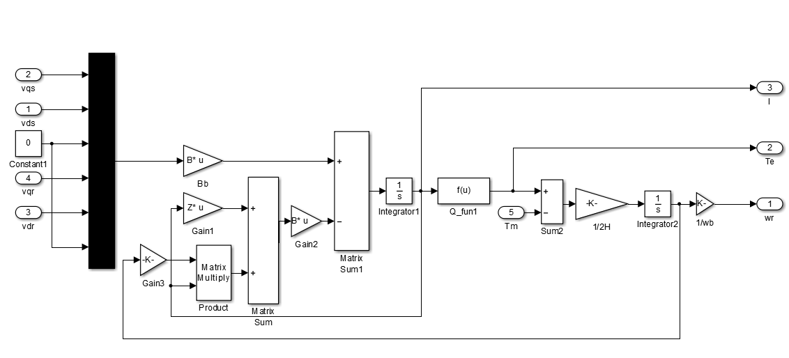
Induction Machine Model

Slide 7
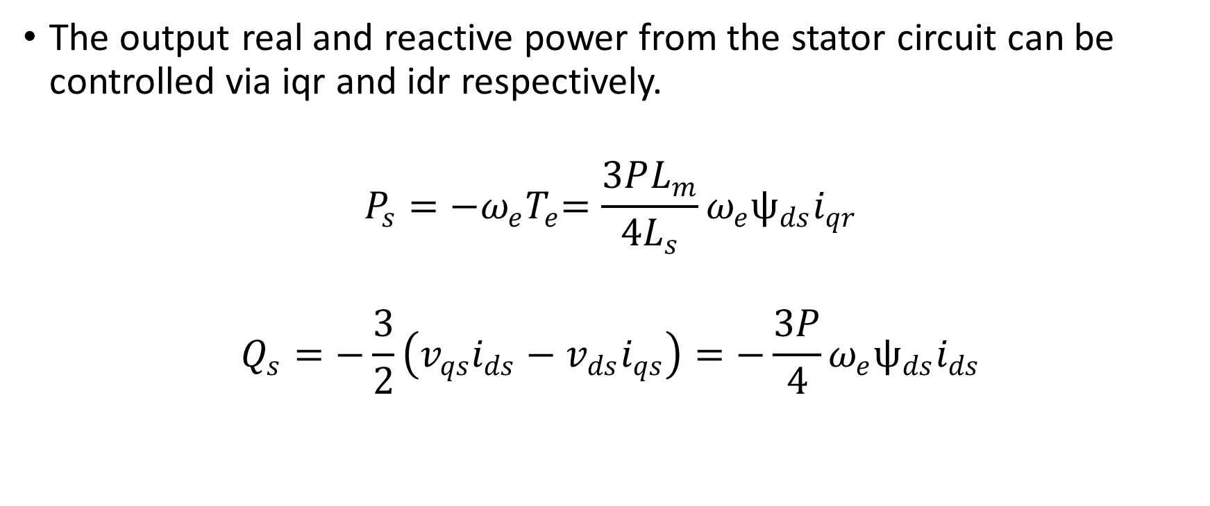
DFIG Rotor Side Converter Positive Sequence Control
The output real and reactive power from the stator circuit can be controlled via iqr and idr respectively.
$$P_{s}={−ω_{e}T}_{e}=\frac{3PL_{m}}{4L_{s}}ω_{e}ѱ_{ds}i_{qr}$$
$$Q_{s}=−\frac{3}{2}\left(v_{qs}i_{ds}−v_{ds}i_{qs}\right)=−\frac{3P}{4}ω_{e}ѱ_{ds}i_{ds}$$

Slide 8
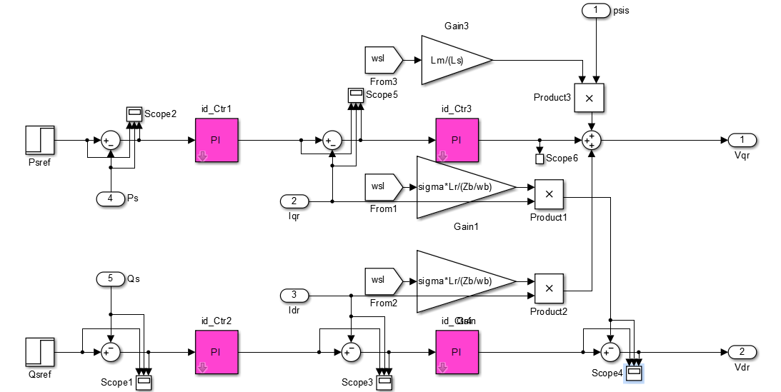
Positive Sequence Controller in RSC

Slide 9
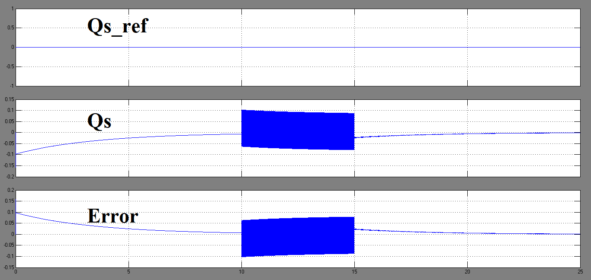
Positive Sequence RSC Control of Stator Power Qs

Slide 10
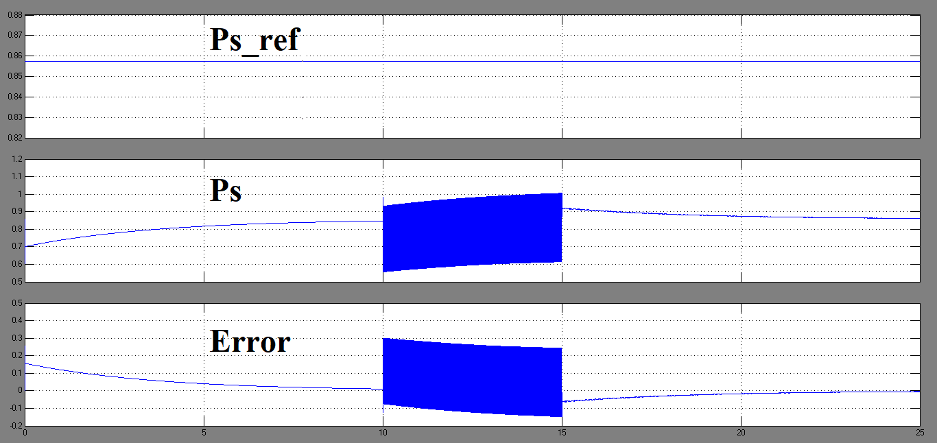
Positive Sequence RSC Control of Stator Power Ps

Slide 11
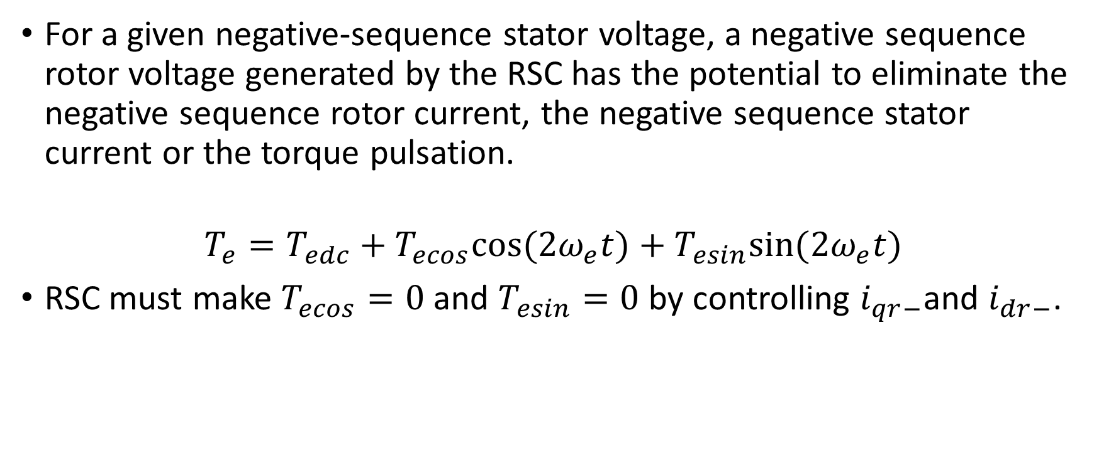
DFIG Rotor Side Converter Negative Sequence Control
For a given negative-sequence stator voltage, a negative sequence rotor voltage generated by the RSC has the potential to eliminate the negative sequence rotor current, the negative sequence stator current or the torque pulsation.
$$T_{e}=T_{edc}+T_{ecos}cos⁡(2ω_{e}t)+T_{esin}sin⁡(2ω_{e}t)$$
RSC must make $T_{ecos}=0$ and $T_{esin}=0$ by controlling $i_{qr−}$and $i_{dr−}$.

Slide 12
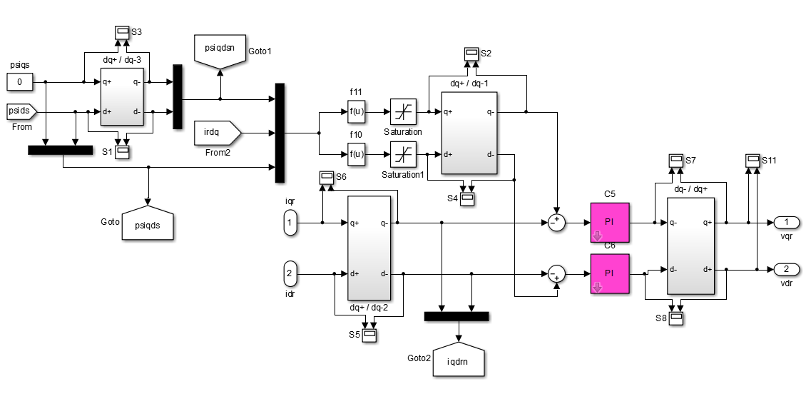
Negative Sequence Controller in RSC

Slide 13
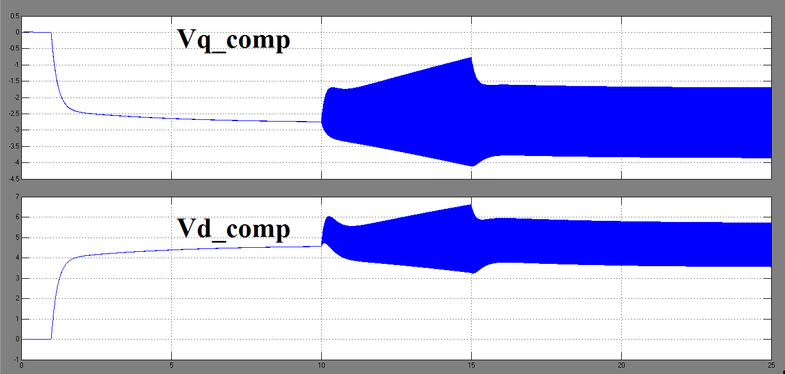
Negative Sequence Compensation via RSC

Slide 14
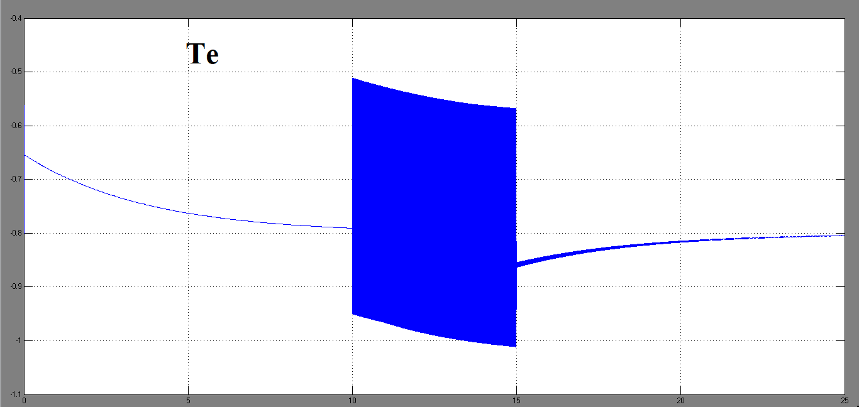
Torque Response

Slide 15
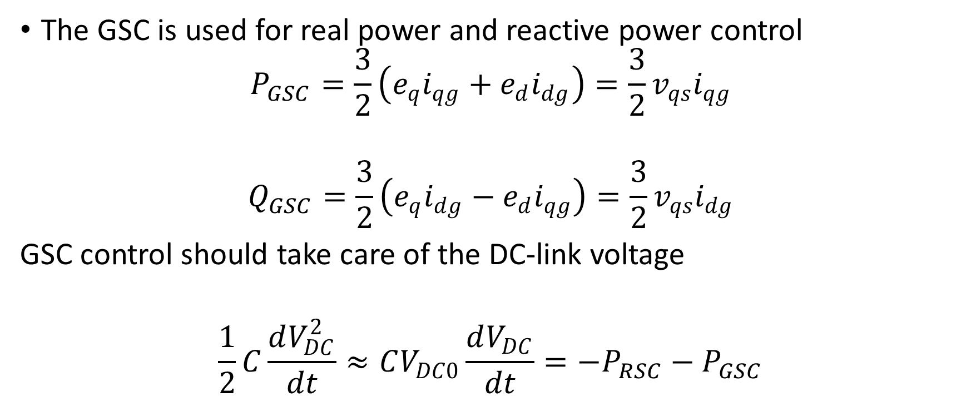
DFIG Grid Side Converter Positive Sequence Control
The GSC is used for real power and reactive power control
$$P_{GSC}=\frac{3}{2}\left(e_{q}i_{qg}+e_{d}i_{dg}\right)=\frac{3}{2}v_{qs}i_{qg}$$
$$Q_{GSC}=\frac{3}{2}\left(e_{q}i_{dg}−e_{d}i_{qg}\right)=\frac{3}{2}v_{qs}i_{dg}$$
GSC control should take care of the DC-link voltage
$$\frac{1}{2}C\frac{dV_{DC}^{2}}{dt}≈CV_{DC0}\frac{dV_{DC}}{dt}=−P_{RSC}−P_{GSC}$$

Slide 16
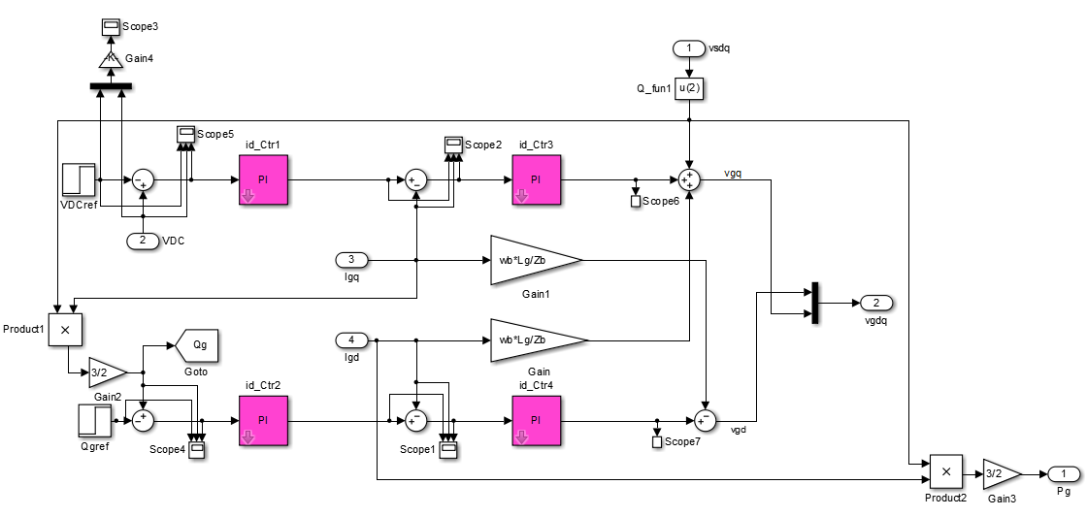
Positive Sequence Controller in GSC

Slide 17
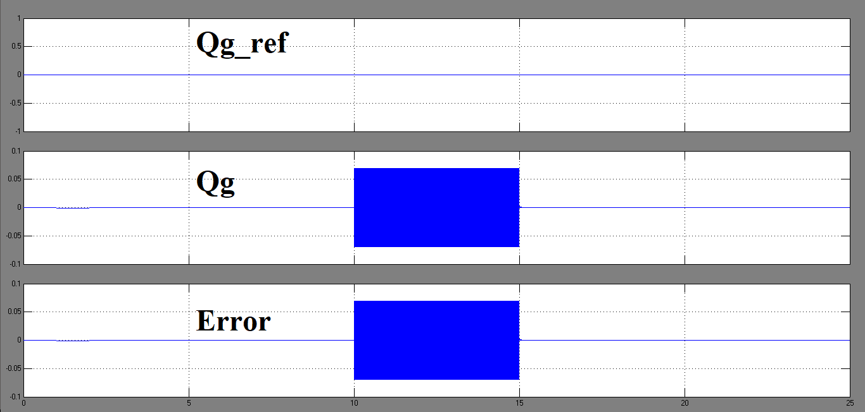
Positive Sequence GSC Control of GSC Power Q_GSC

Slide 18
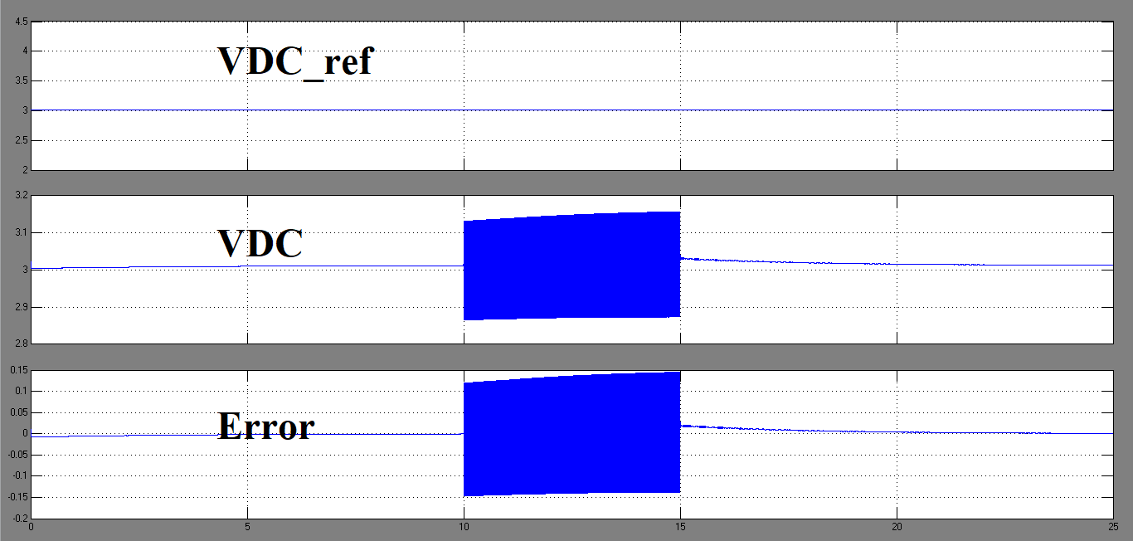
Positive Sequence GSC Control of DC Link Voltage VDC

Slide 19
DFIG Grid Side Converter Negative Sequence Control
For negative sequence compensation via GSC, the current controllers of the GSC will measure the network currents, extract the negative sequence components and generate the required negative sequence currents from the GSC for compensation.
The reference values of the negative sequence currents come from the measurements of the currents to the grid.

Slide 20
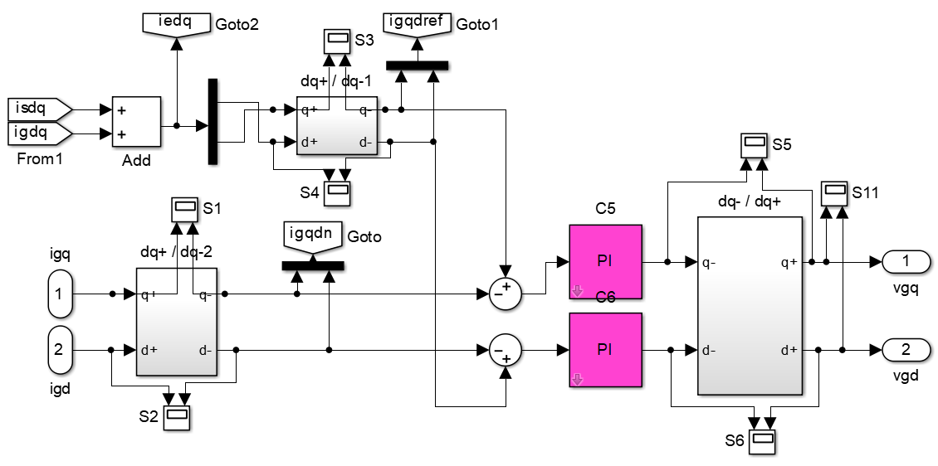
Negative Sequence Controller in GSC

Slide 21
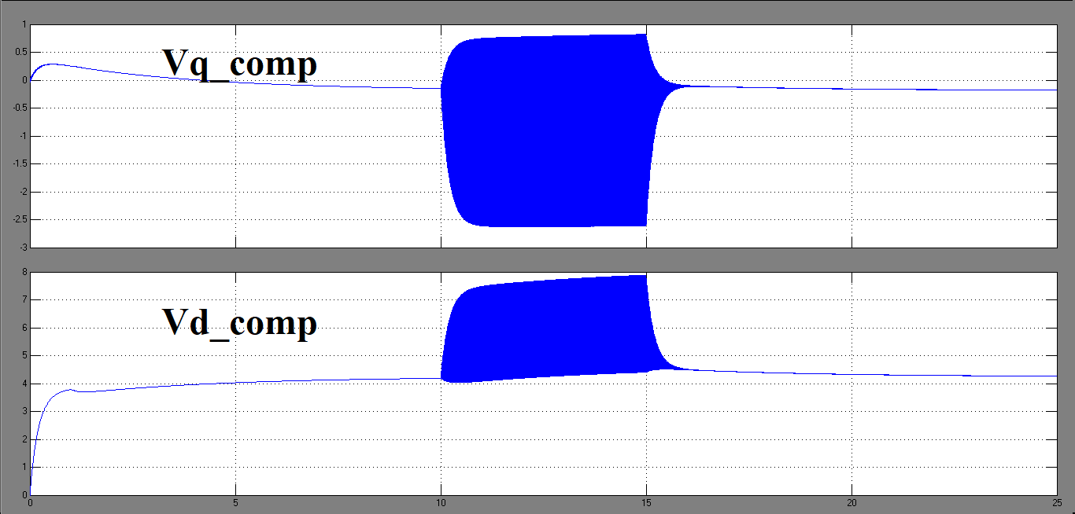
Negative Sequence Compensation via GSC

Slide 22
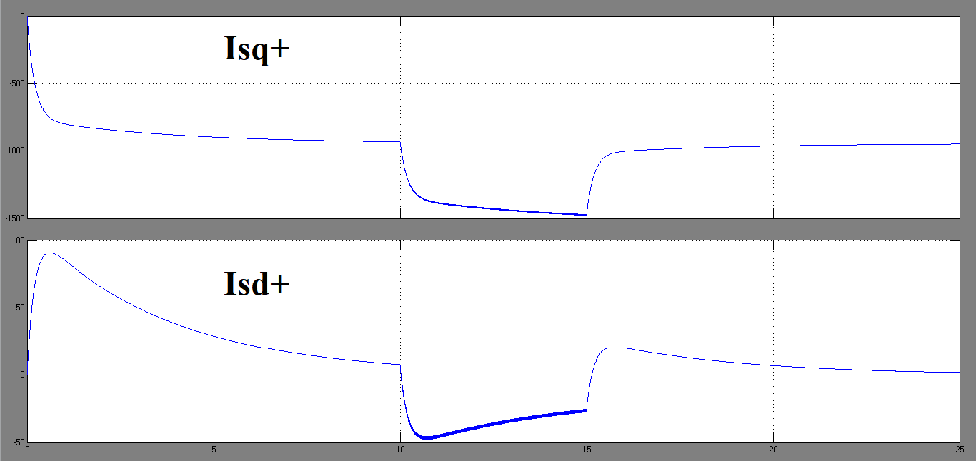
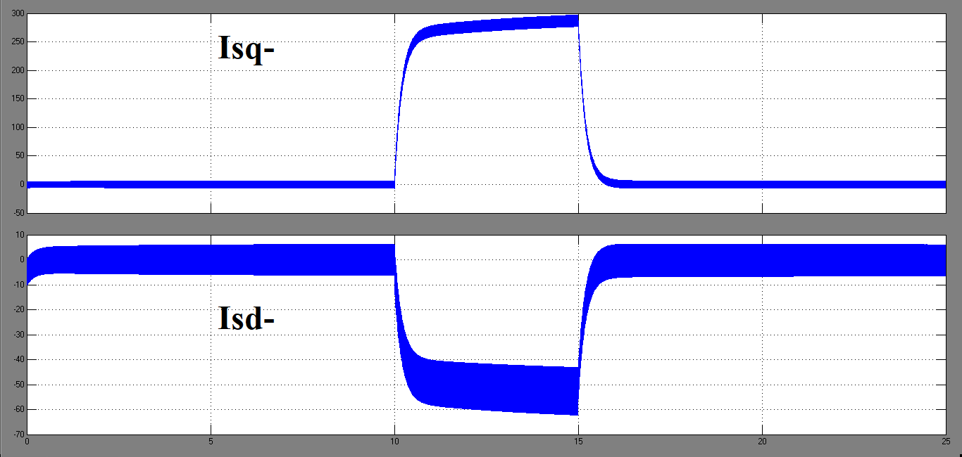
Stator Currents

Slide 23
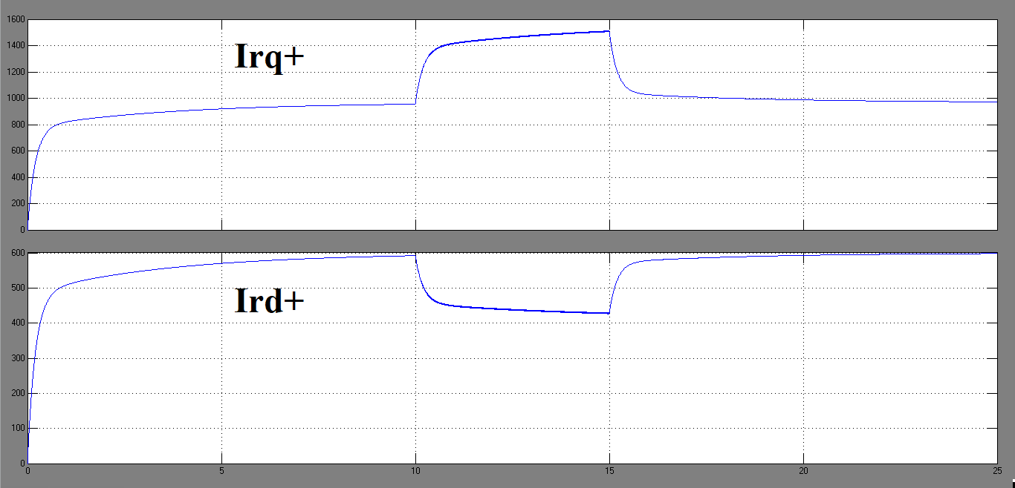
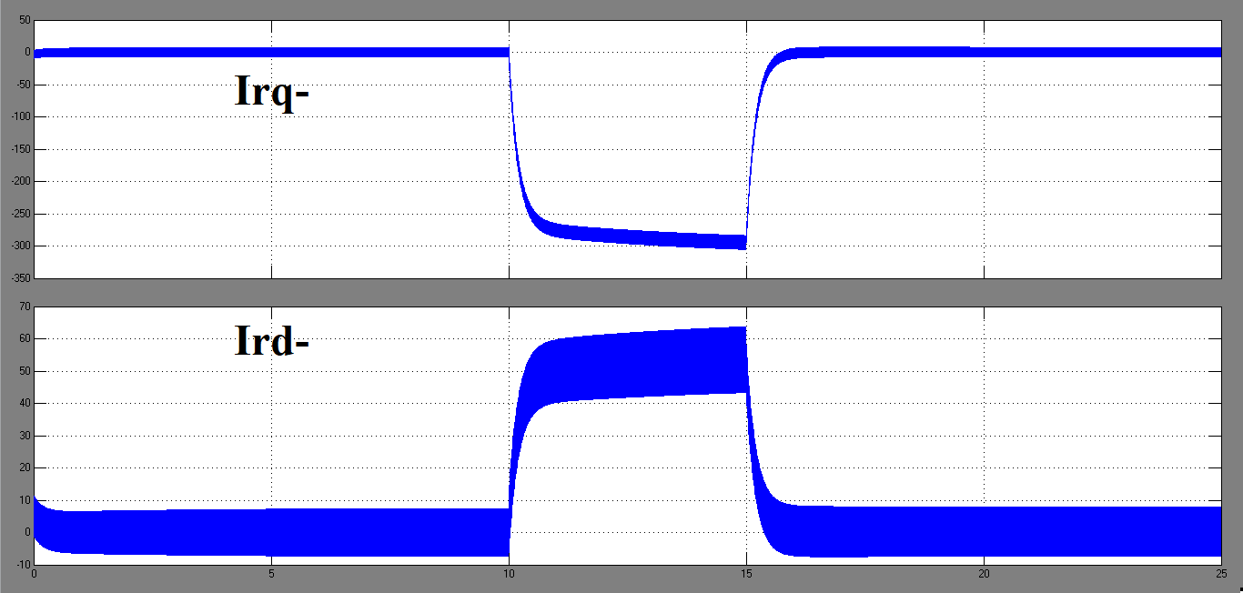
Rotor Currents

Slide 24
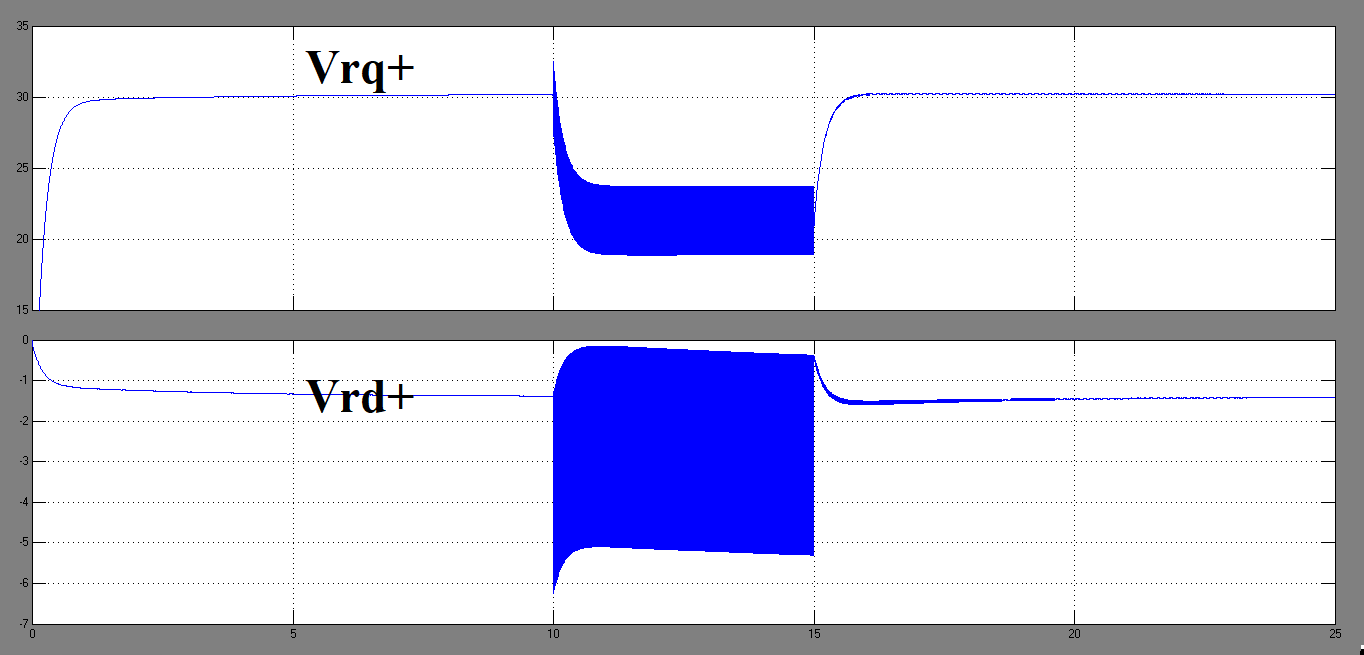
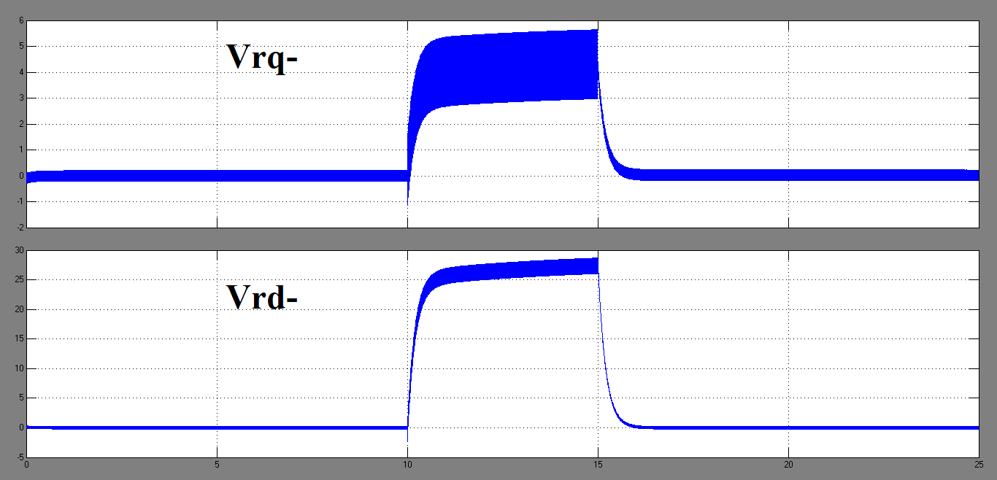
Rotor Voltages

Slide 25
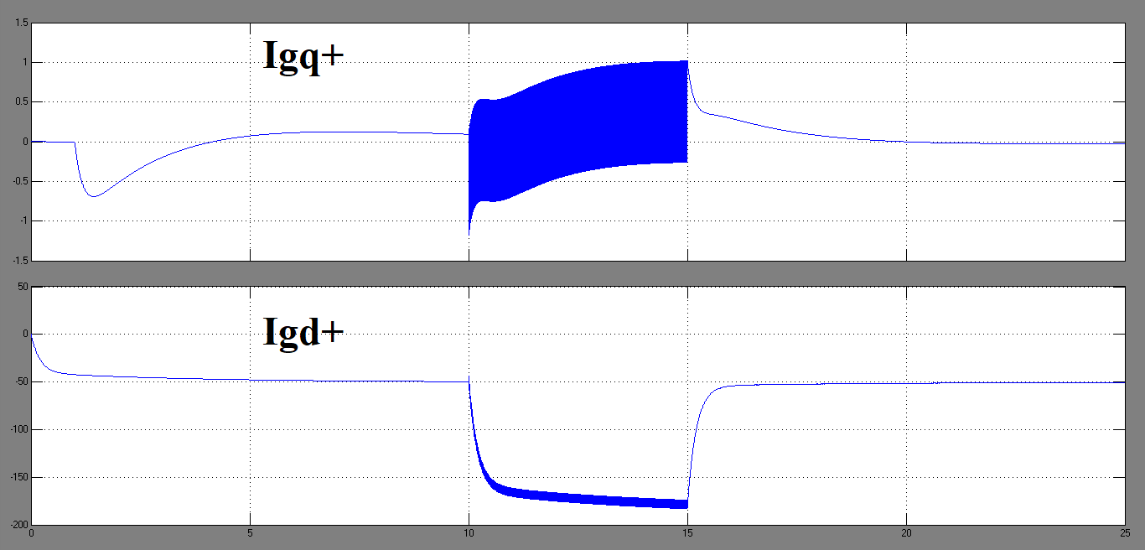
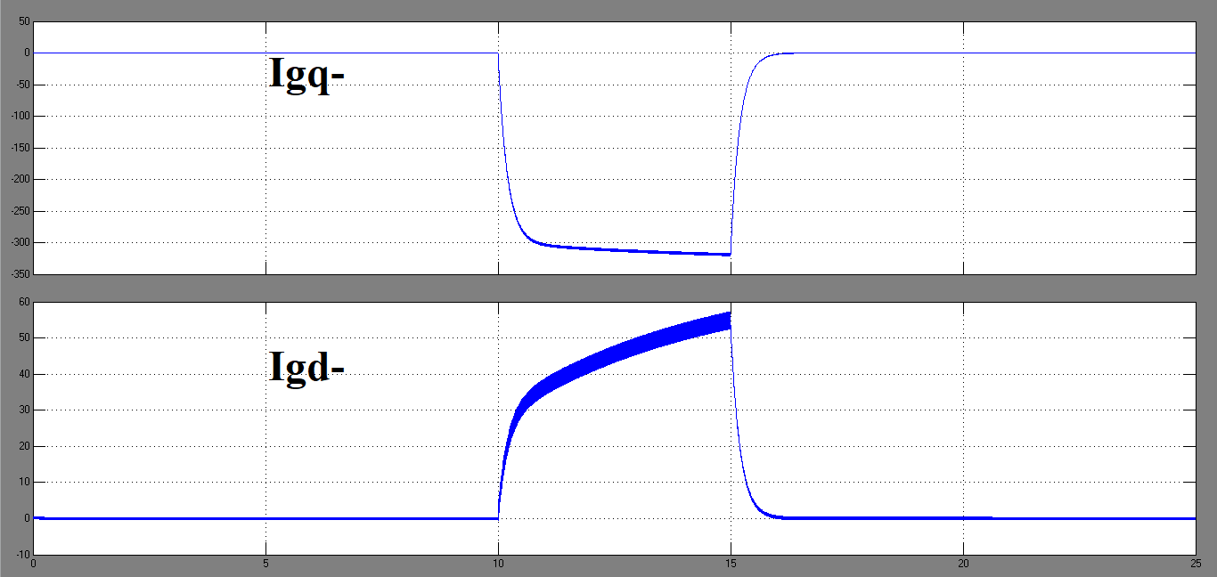
GSC Currents

Slide 26
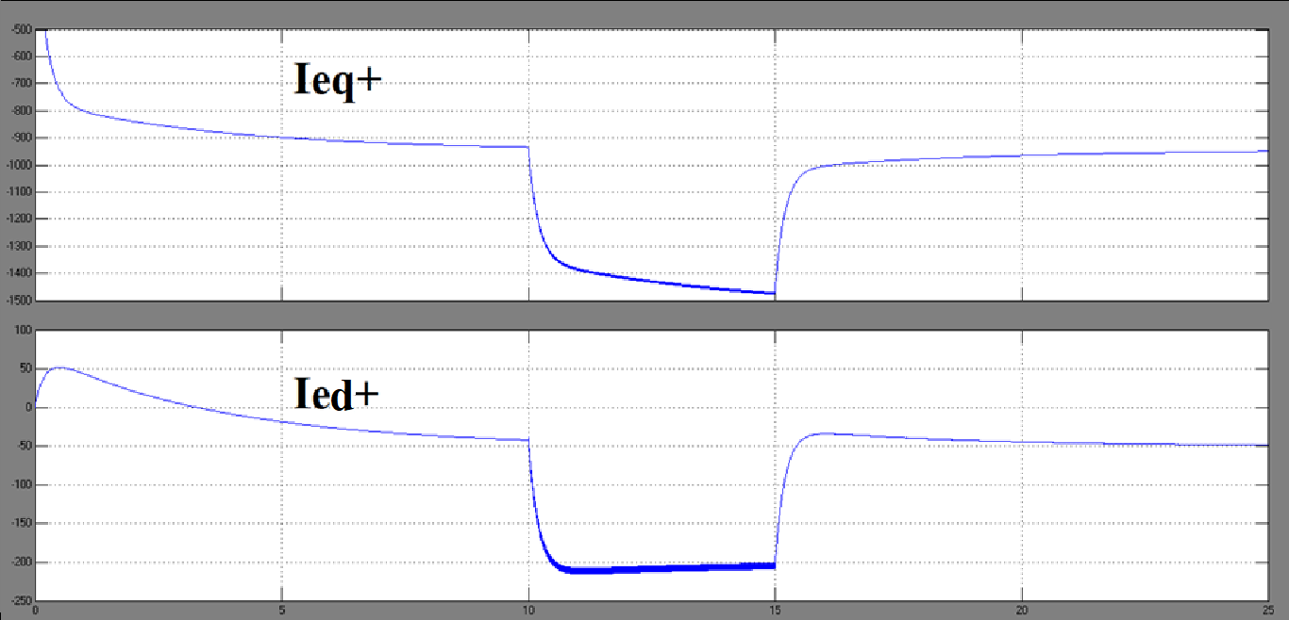
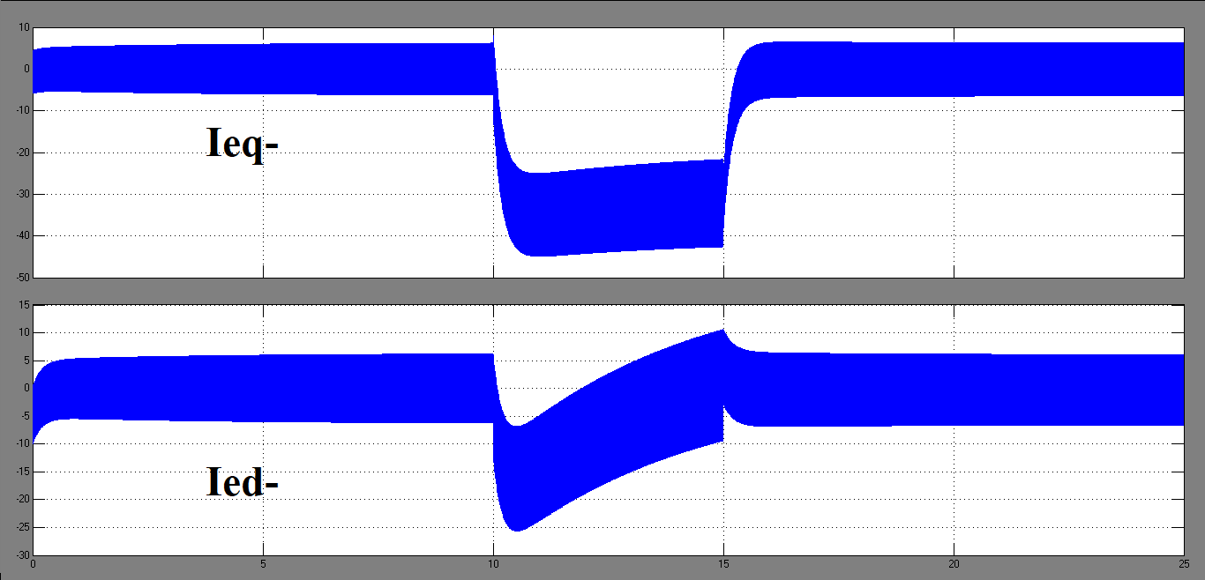
Grid Currents

Slide 27
Summary
Due to unbalanced stator voltage conditions, negative-sequence components in stator currents induce a high frequency component (ωe+ωm) or (2−s)ωe in rotor currents and pulsations at 2ωe frequency in electromagnetic torques.
GSC compensate the negative sequence currents required in the network during any unbalanced operation. It also controls Power delivered to grid by GSC and DC Link Voltage.
RSC has the potential to eliminate negative sequence rotor currents, negative sequence stator currents or torque pulsation. It also controls Active and Reactive Power delivered by stator.

Slide 28
References
L. Fan and Z. Miao, Modeling and Analysis of Doubly Fed Induction Generator Wind Energy Systems, Elsevier Ltd., 2015, 1-78.
R. Pena, J. Clare, G. Asher, Doubly fed induction generator using back-to-back pwm converters and its application to variable-speed wind-energy generation, IEEE Proc. Electr. Power Appl. 143(3), 1996, 231-241.
R. Pena, R. Cardenas, E. Escobar, Control system for unbalanced operation of stand-alone doubly fed induction generators, IEEE Trans. Energy Convers. 22(2), 2007, 544-545.

